Slide 1
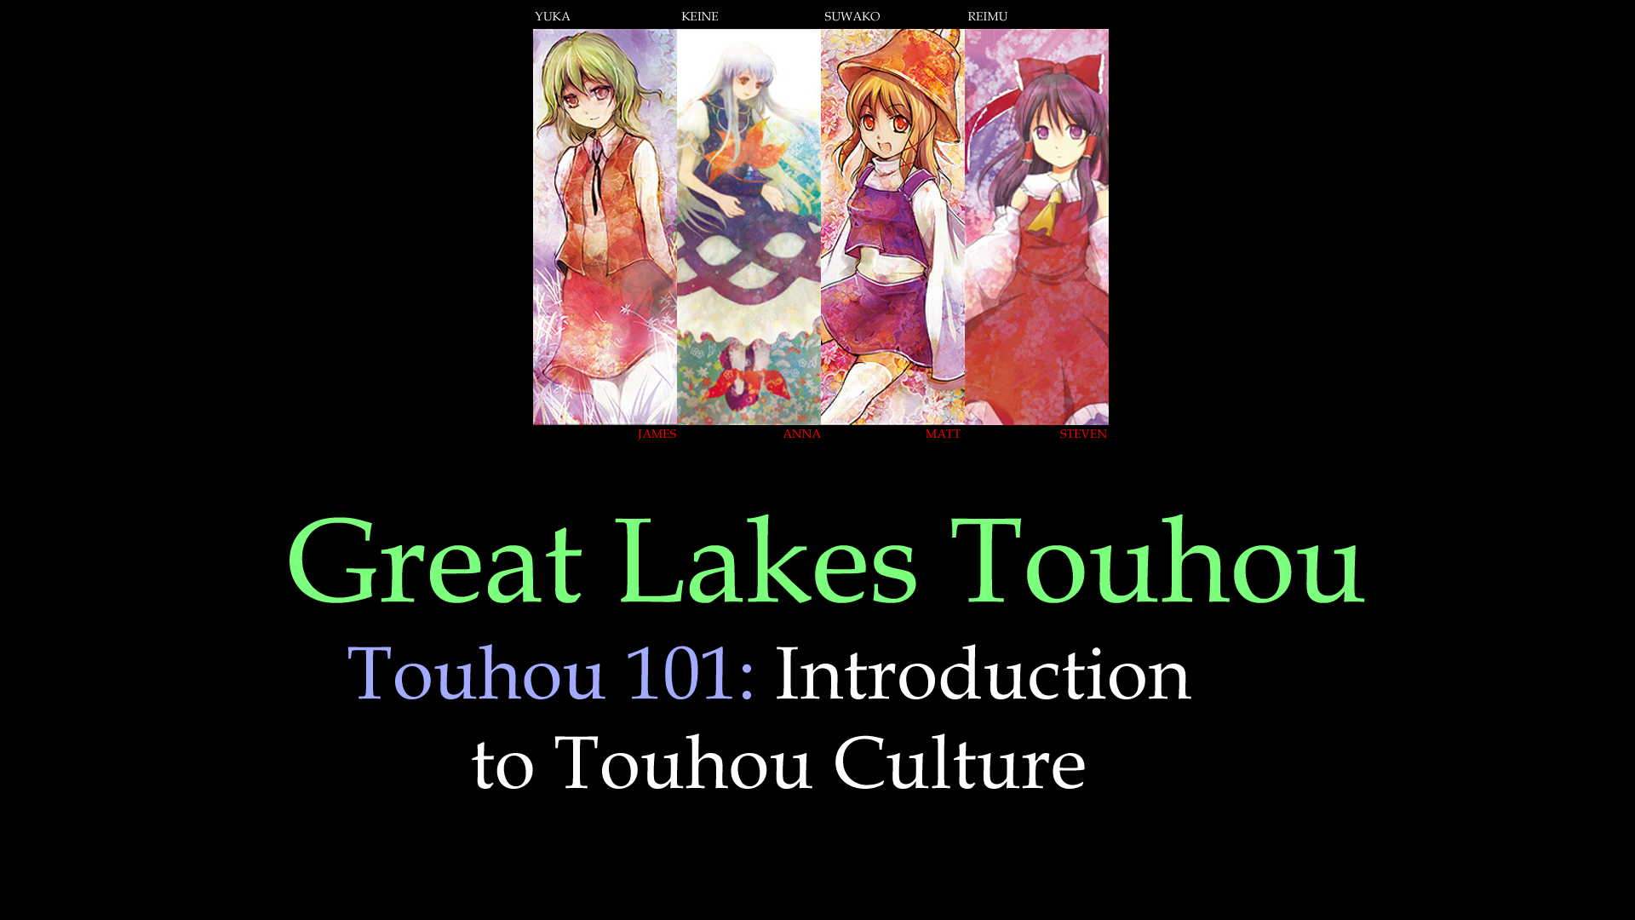
Artwork for cover and panel slides background by: 央子 (Matoko) https://www.pixiv.net/member.php?id=126220

Slide 2
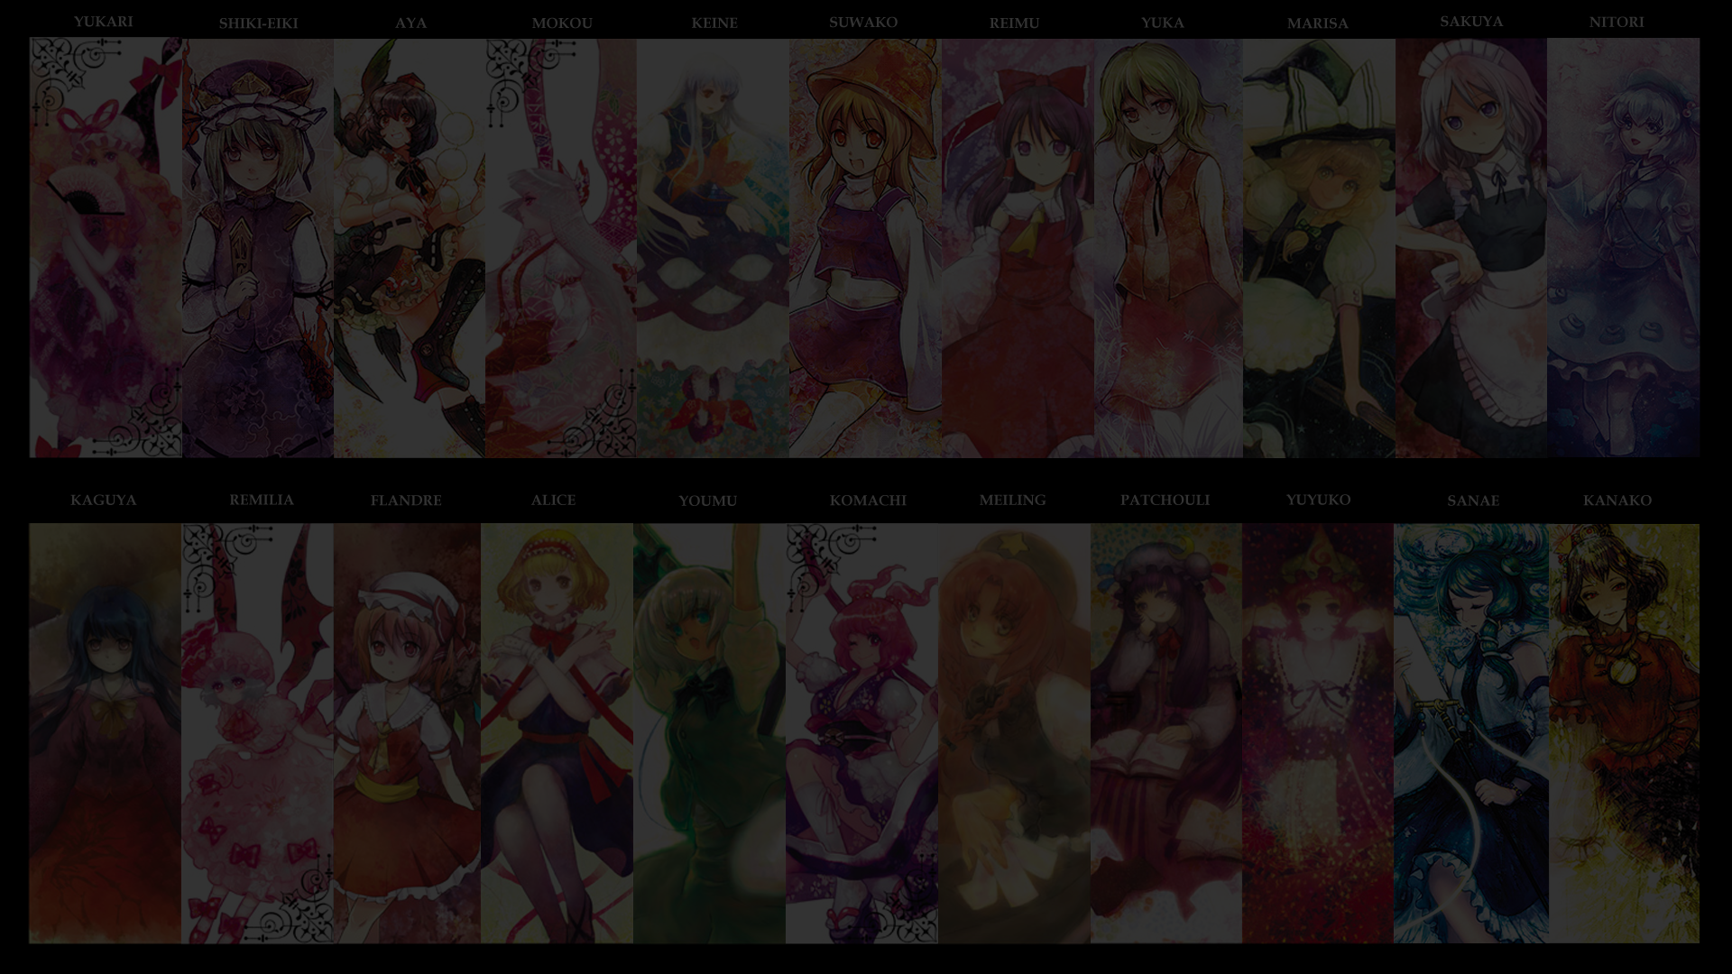
What is Touhou?
Touhou is a video game series,
Created by ZUN (Ōta Jun’ya):
Danmaku (meaning Barrage or more commonly, Bullet Hell)
Multi-Platform (PC-98, Windows, Nintendo Switch, PS4)
Touhou in Society:
Cultural Phenomenon
Guiness World Record Holder
Touhou fandom:
Games, Manga, Anime
Artwork, Music
Communities
Notes:
東方 (Touhou) is a video game series created by “ZUN” a.k.a. 太田 順也 (Ōta Jun’ya). His games are usually a 弾幕 (danmaku) meaning , “Barrage”.
But most importantly, Touhou is a Japanese cultural phenomenon.
(Guiness world record holder for “world’s most prolific fan-made shooter series”.)
It started as a Side project of ZUN’s, and eventually took off to become one of the largest fandoms in Japan. The fandom is mostly due to the spirit of what the Japanese refer to as “Doujin Culture”. ZUN, is a firm believer in Doujin Culture, and thus allows derivative works to be produced and sold independently in first hand markets (E.G. Comiket), and more recently has begun to allow some games to be sold on certain platforms such as Steam, PS4 and the Nintendo Switch. Because of this, his characters have been used in a large variety of fan made media, including manga, anime, and other games.

Slide 3
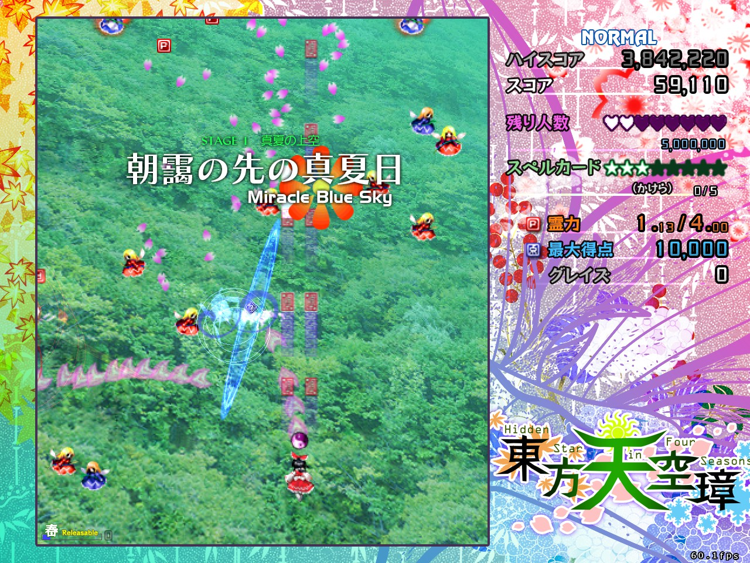
Notes:
Go to gameplay

Slide 4
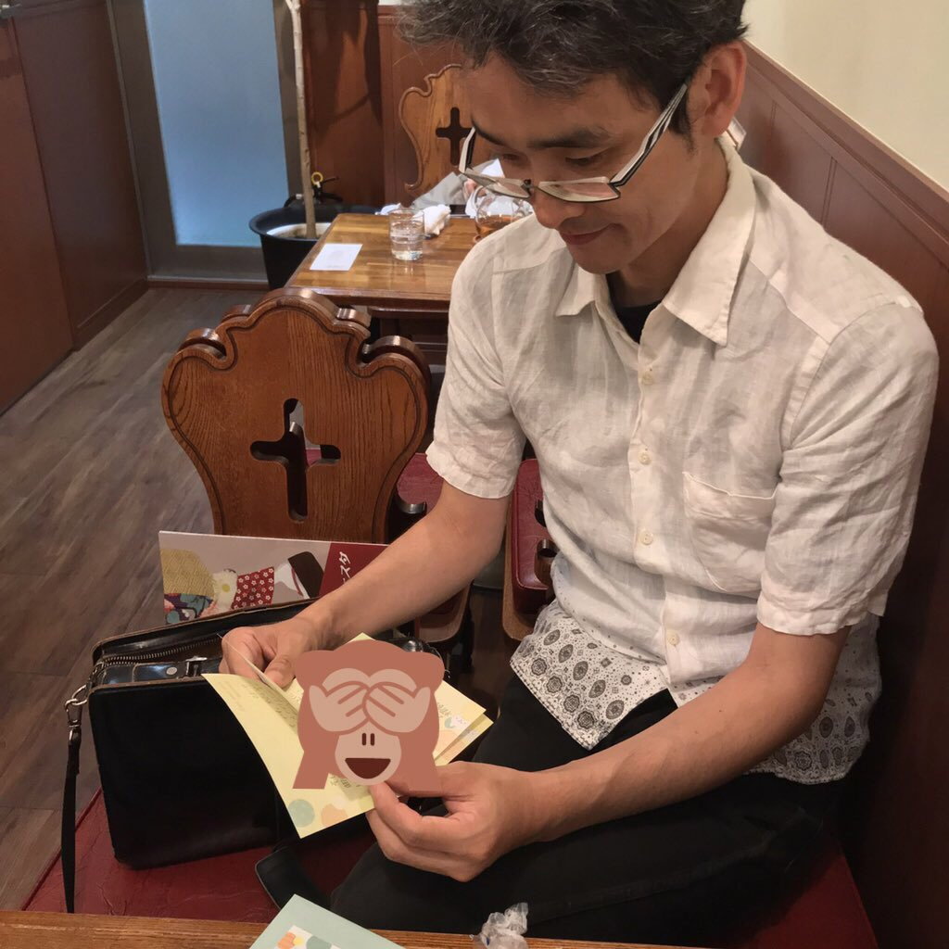
About ZUN
Web Presence:
https://www16.big.or.jp/~zun/ https://twitter.com/korindo
Key facts:
Former Employee of Taito Corporation
Musician
Game Developer
Beer Enthusiast
Family Man
https://twitter.com/korindo/status/1050612816435019776
Notes:
Games Before Touhou:
International League Soccer (2000) (Known as Greatest Striker in Japan)
Magic Pengel (2002)
Bujingai (2003)
Graffiti Kingdom (2004)
EXIT (2005)

Slide 5
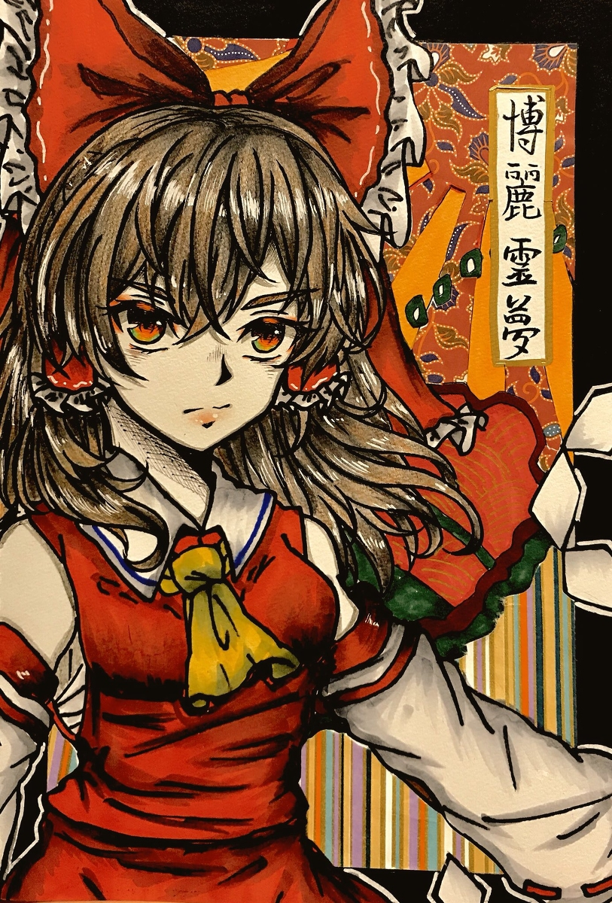
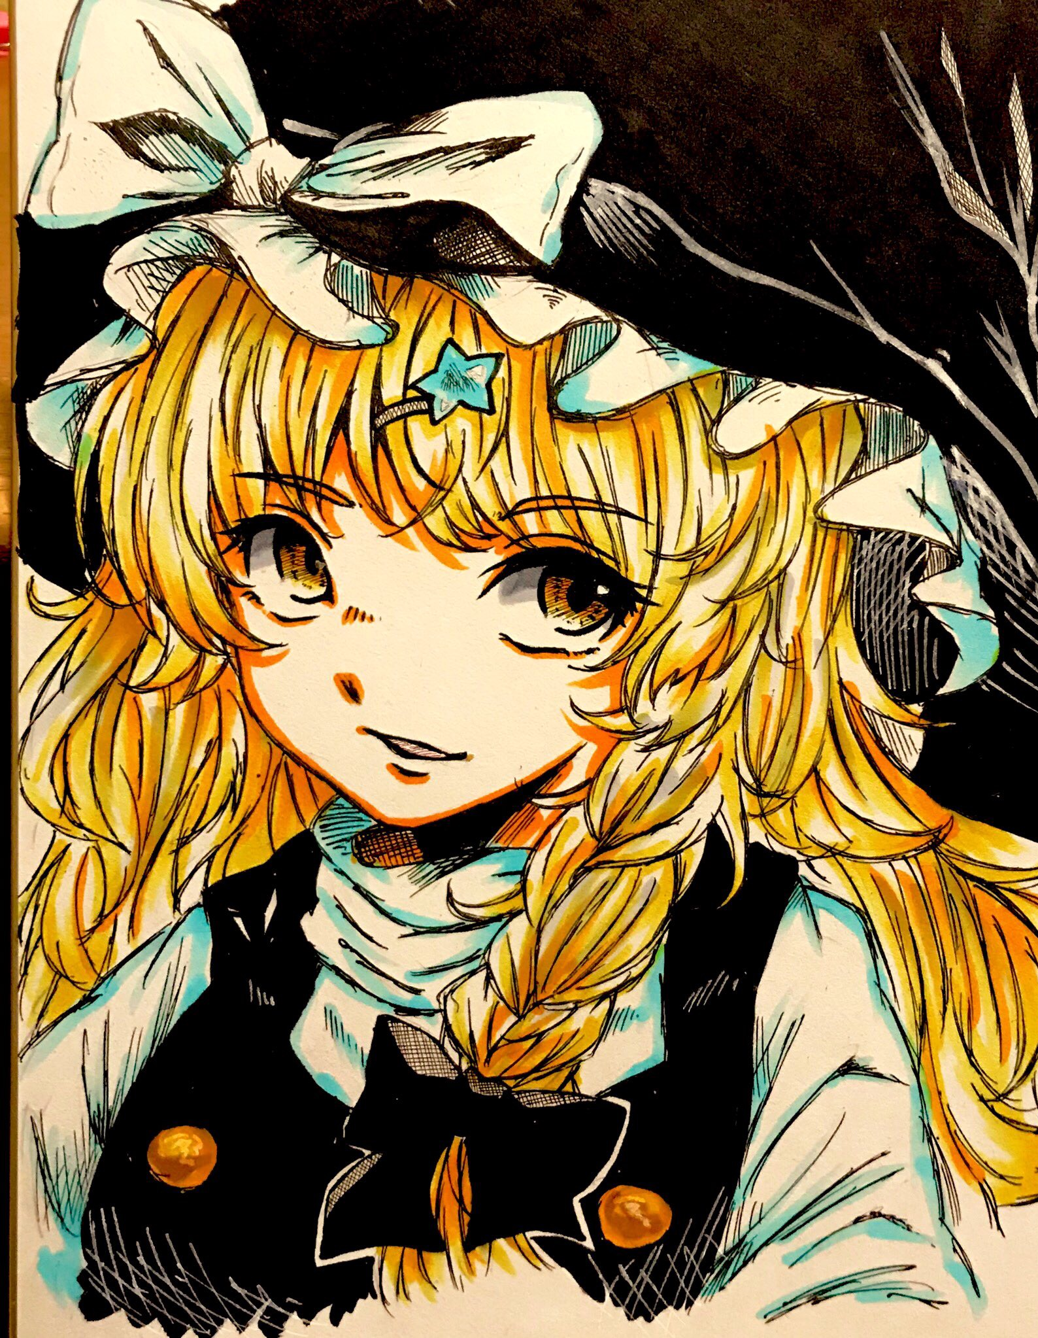
Characters?
His characters, mostly come from the concept of moe gijinka, which is the act of taking something normally not cute, and personifying it as something cute and relatable.
There are over 150 different characters.
Two main recurring characters:
Reimu Hakurei Marisa Kirasame
Unlike most of the others, they are Human.
Source: https://www.pixiv.net/member_illust.php?mode=medium&illust_id=70939576
Source: https://www.pixiv.net/member_illust.php?mode=medium&illust_id=72412035
Notes:
In ZUN’s particular case, he usually focus’s on 妖怪 (Youkai), which are ghost like demons or monsters, which usually appear in Japanese fokelore.

Slide 6
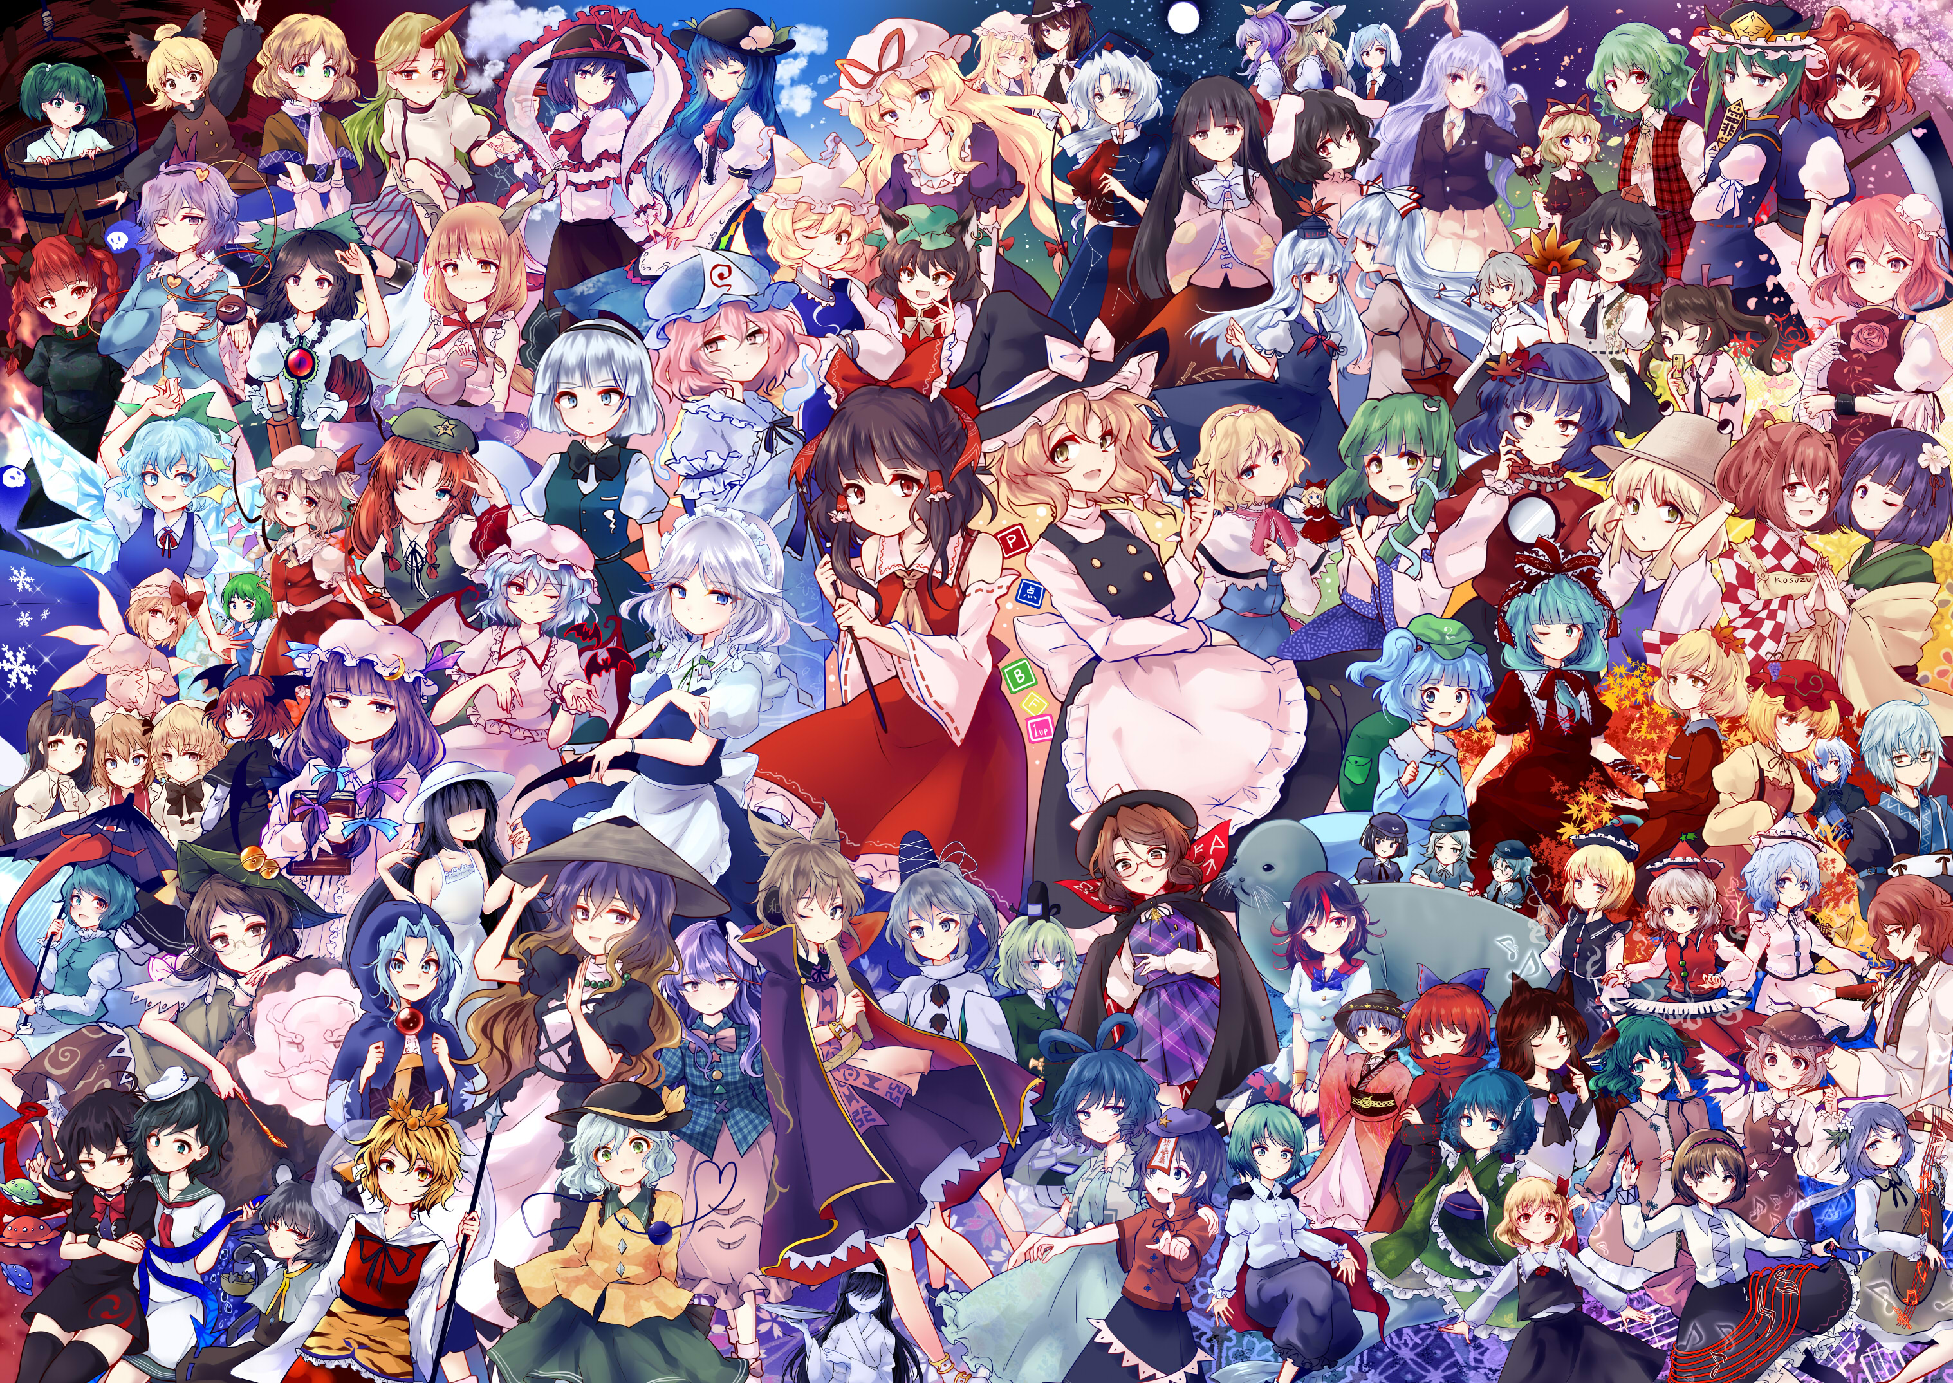

Slide 7
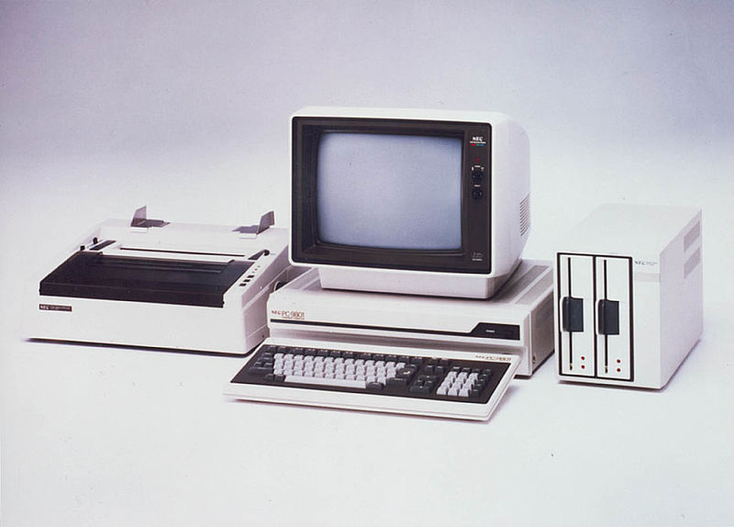
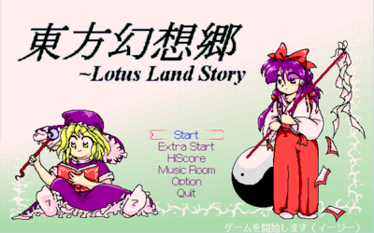
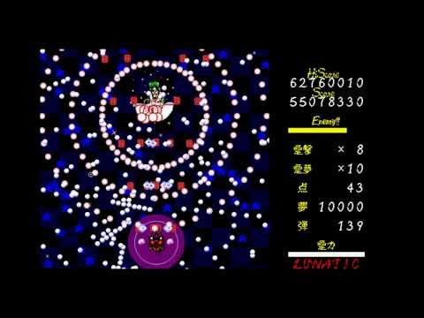
PC 98 Era (1996-1998)
1. Highly Responsive to Prayers
(Break Out Game)
2. Story of Eastern Wonderland
3. Phantasmagoria of Dim. Dream
(Versus Game)
4. Lotus Land Story
5. Mystic Square
Source: https://necretro.org/File:PC9800_set.jpg

Slide 8
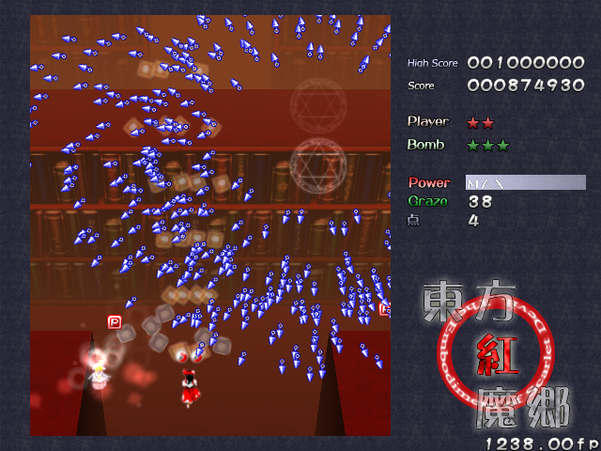
Early Windows Era (2002-2005)
6. Embodiment of Scarlet Devil
7. Perfect Cherry Blossom
7.5 Immaterial And Missing Power
(Fighting Game / Twilight Frontier)
8. Imperishable Night
9. Phantasmagoria of Flower View
(Versus Game)
9.5 Shoot the Bullet
(Puzzle Game)

Slide 9
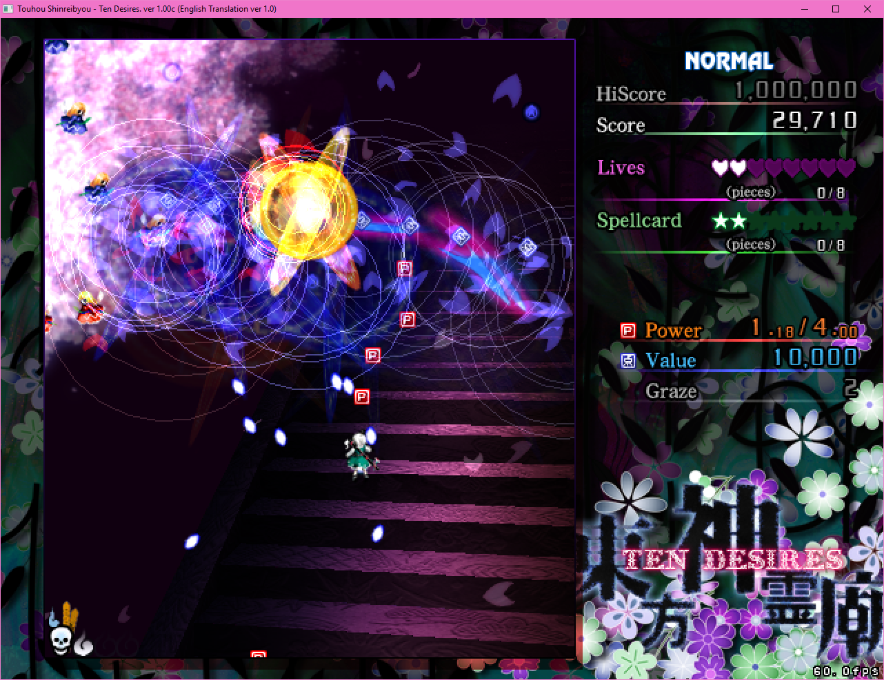
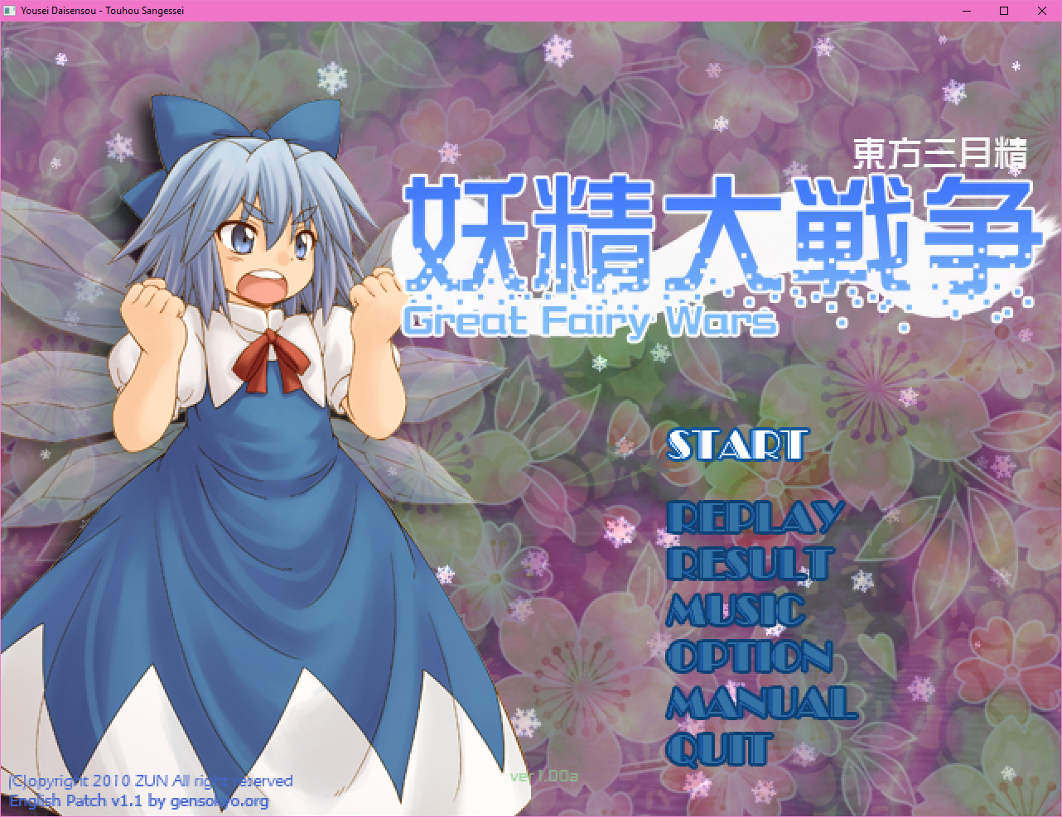
Mid Era (2007-2011)
10. Mountain of Faith
10.5 Scarlet Weather Rhapsody
(Fighting Game / Twilight Frontier)
11. Subterranean Animism
12. Undefined Fantastic Object
12.3 Touhou Hisōtensoku
(Fighting Game / Twilight Frontier)
12.5 Double Spoiler
(Puzzle Game)
12.7 Fairy Wars
(Cirno game)
13. Ten Desires

Slide 10
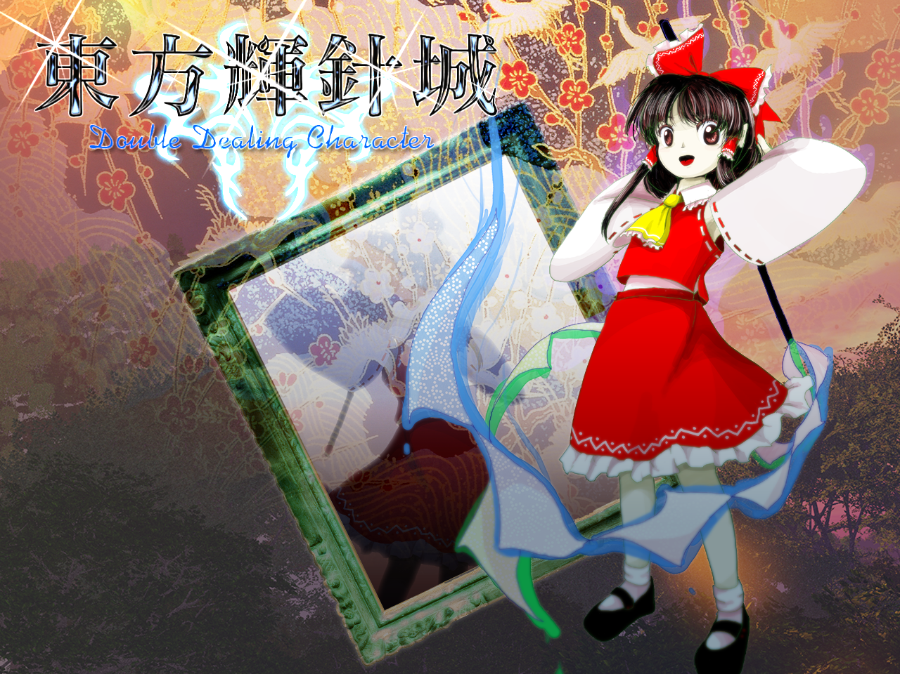
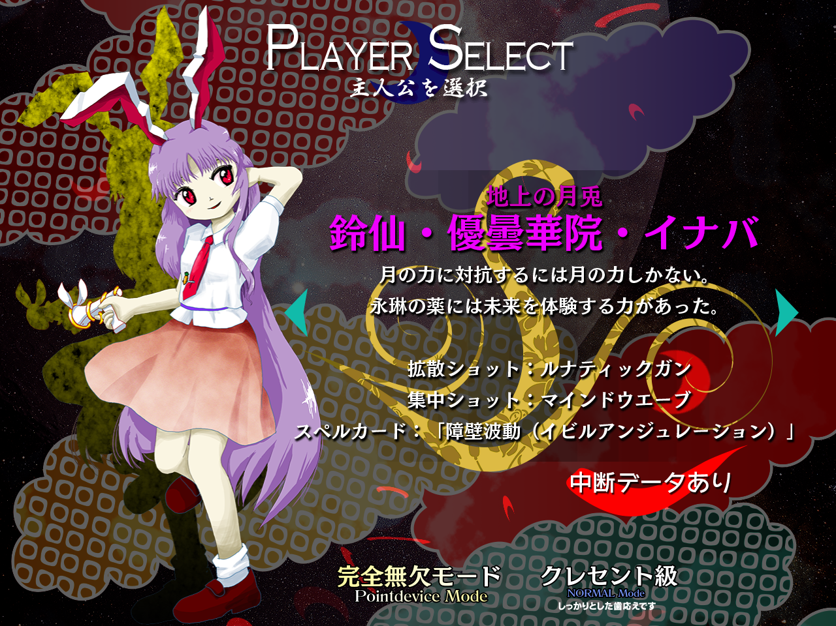
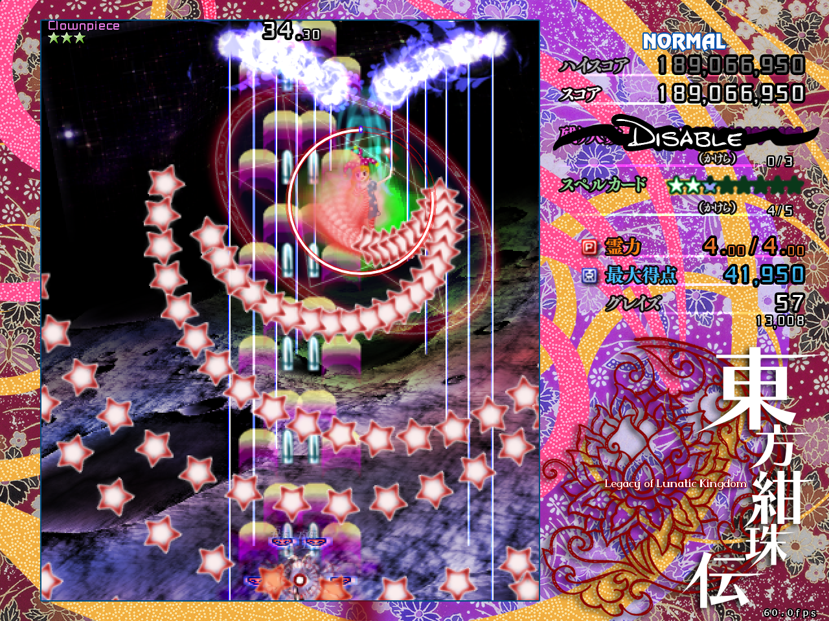
Modern Era (2013 - 2015)
13.5 Hopeless Masquerade
(Fighting Game / Twilight Frontier)
14. Double Dealing Character
14.3 Impossible Spell Card
(Puzzle game)
14.5 Urban Legend in Limbo
15. Legacy of Lunatic Kingdom

Slide 11
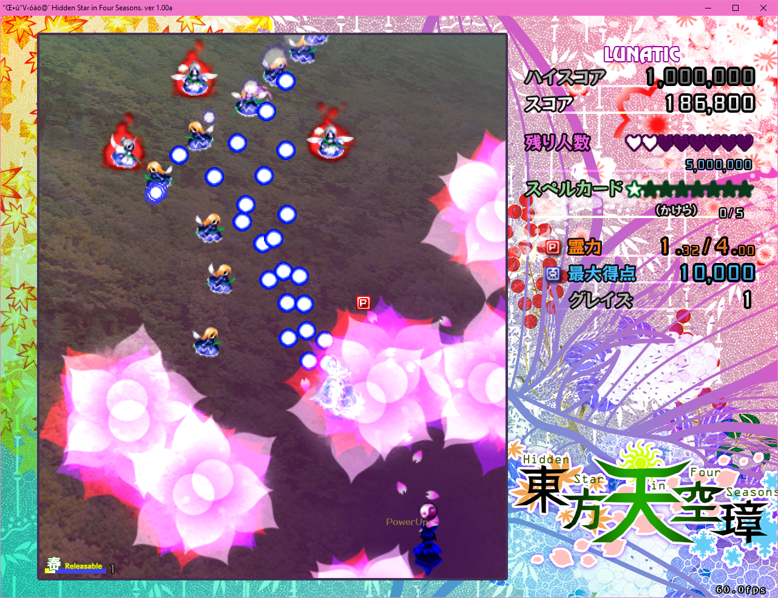
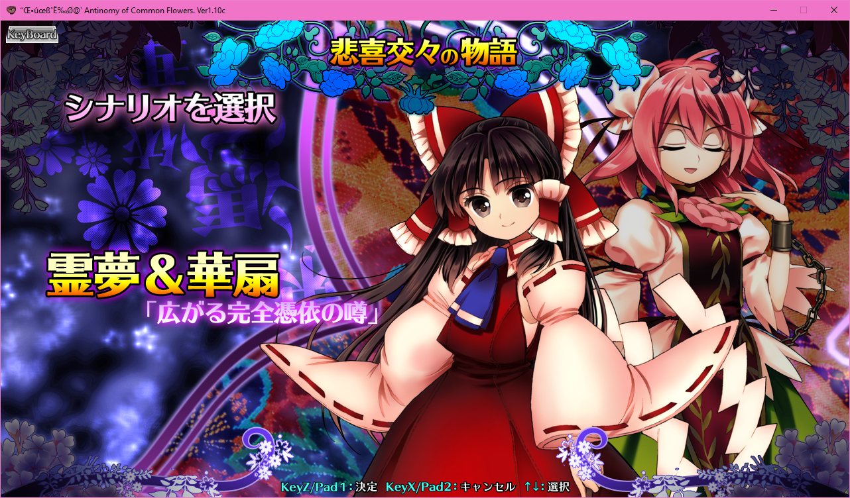
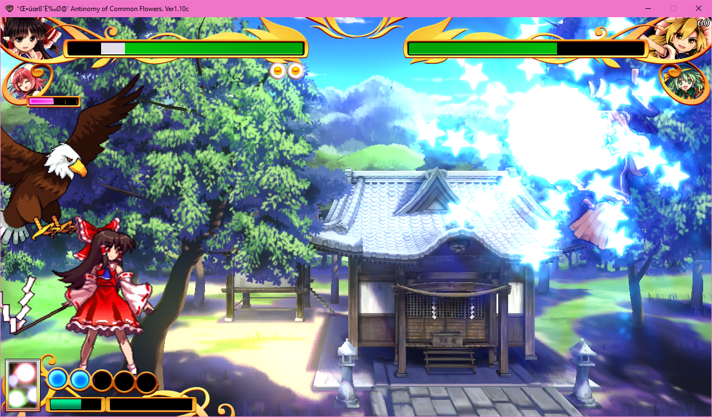
Steam and Onward
ZUN took a break in 2016 for the birth of his child.
Steam is now used for releases.
15.5 Antinomy of Common Flowers
(Fighting Game / Twilight Frontier / Published by Sunfish Co., Ltd.)
16. Hidden Star in Four Seasons
(Published by Mediascape Co., Ltd.)
16.5 Violet Detector
(Puzzle Game / Published by Mediascape Co., Ltd.)
Notes:
Discuss new game and run demo
He no longer hosts any games, demos, or patches on his site.

Slide 12

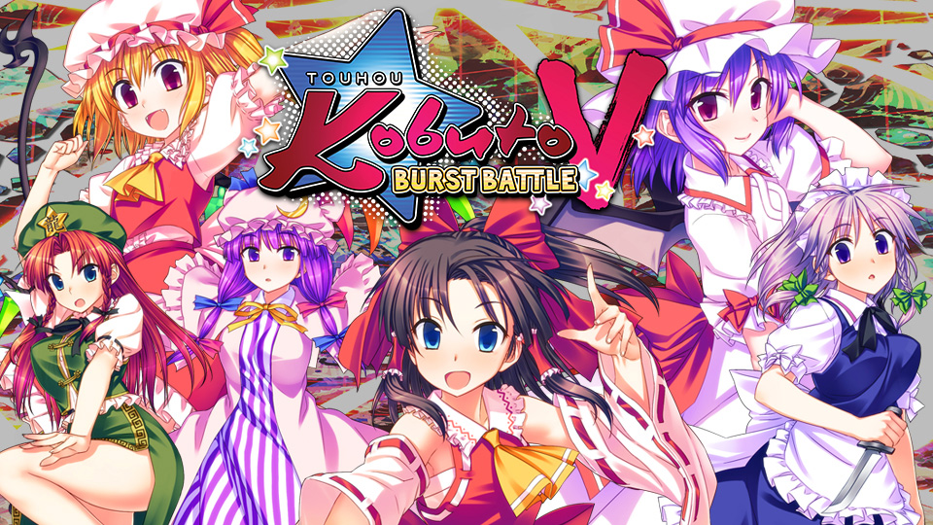
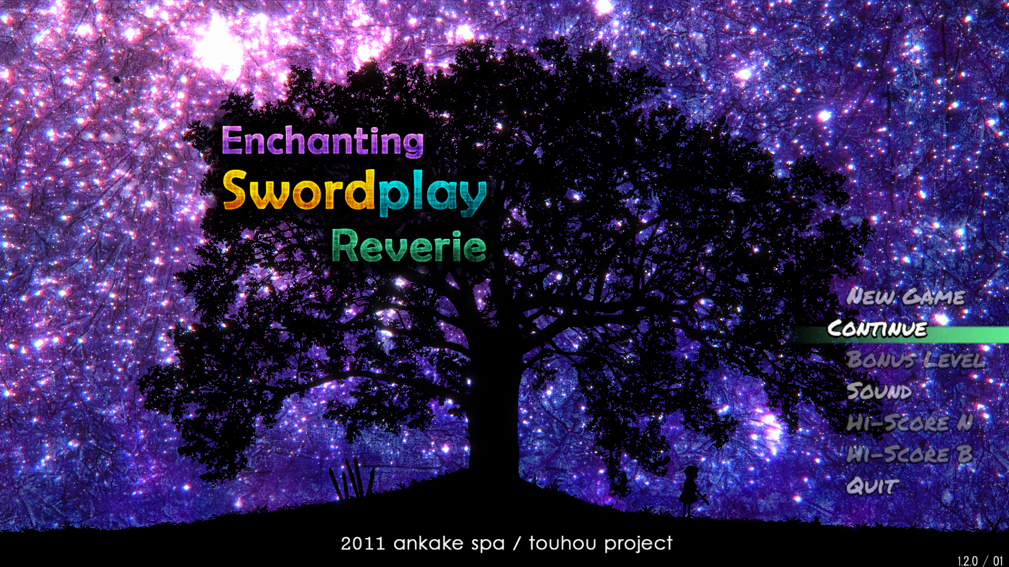
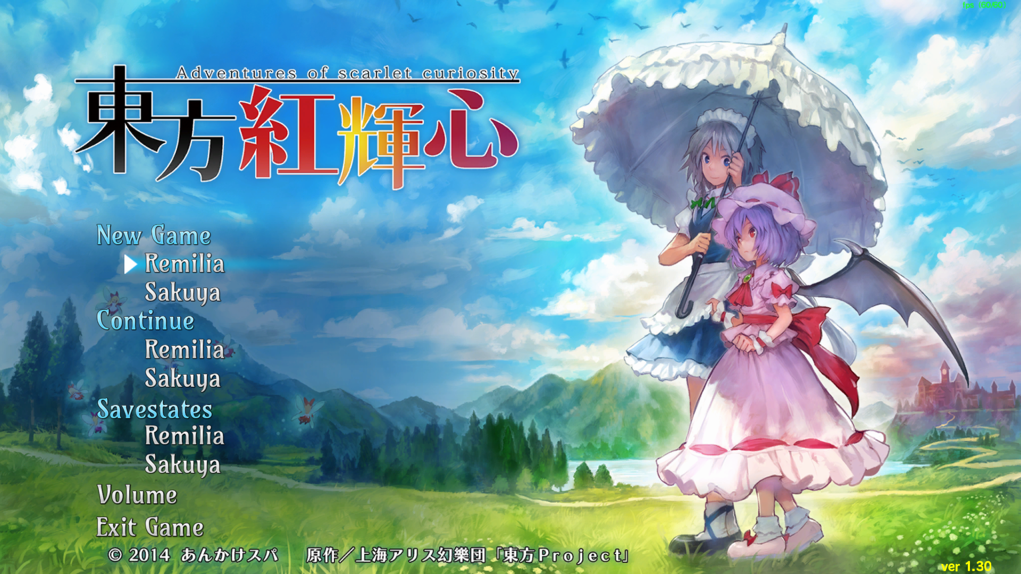
Fan Games
Twilight Frontier has had a major hand in creating several fighting games with ZUN’s input.
NIS has published games created by fan developers. Cubetype’s Touhou Kobuto V: Burst Battle for the Nintendo Switch™ and PS4™ is a recent example.
Ankake Spa is a notable producer using modern graphics.
Youyou Kengeki Musou
Enchanted Swordplay Reverie
Scarlet Curiosity
Adventure of Scarlet Curiosity: Toho Karateiki
Touhou: Scarlet Curiosity

Slide 13
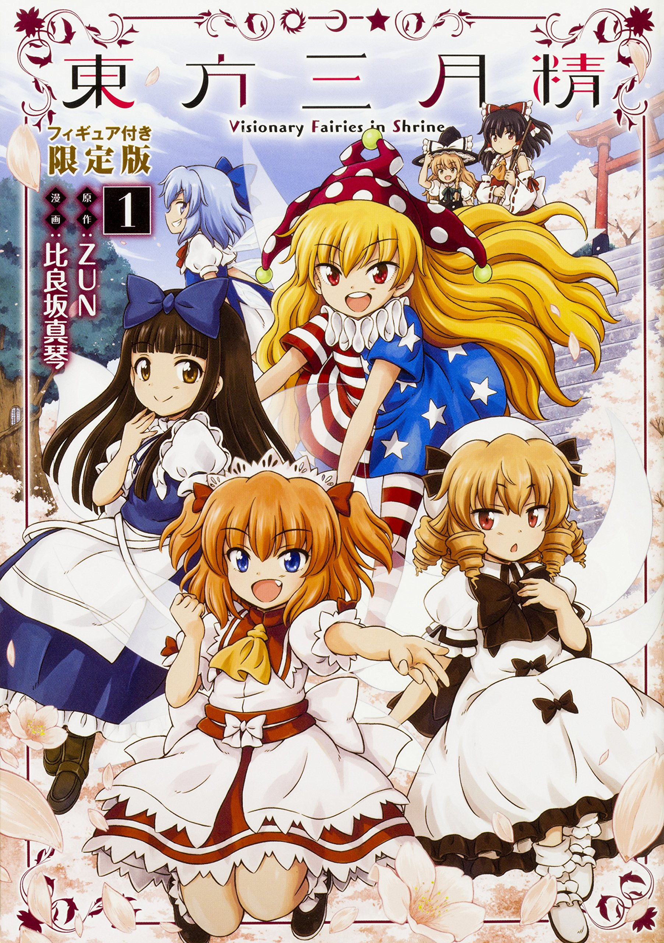
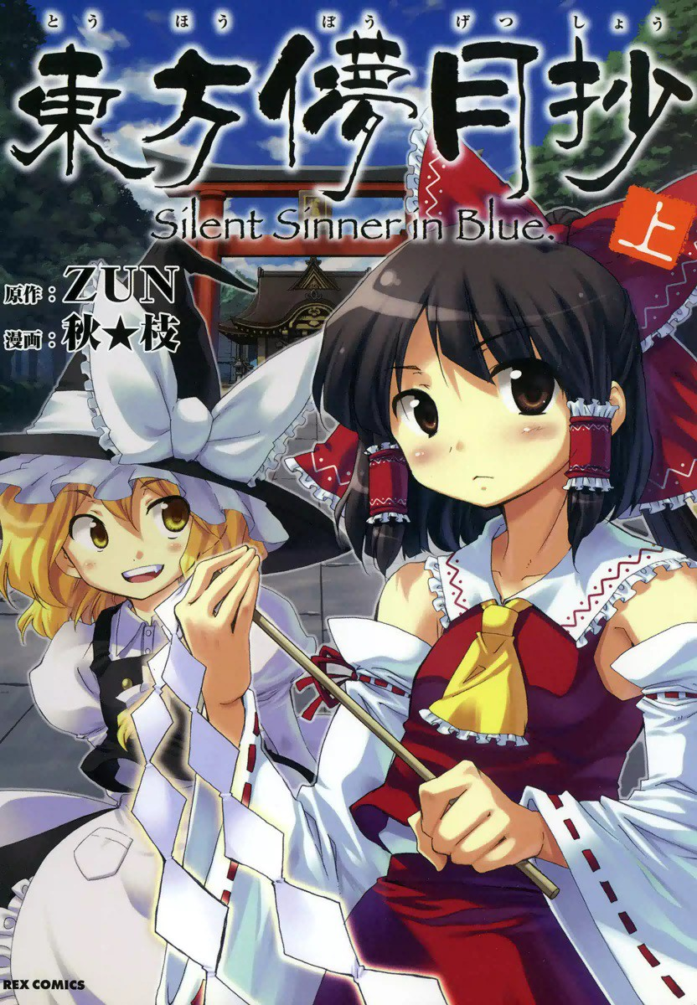
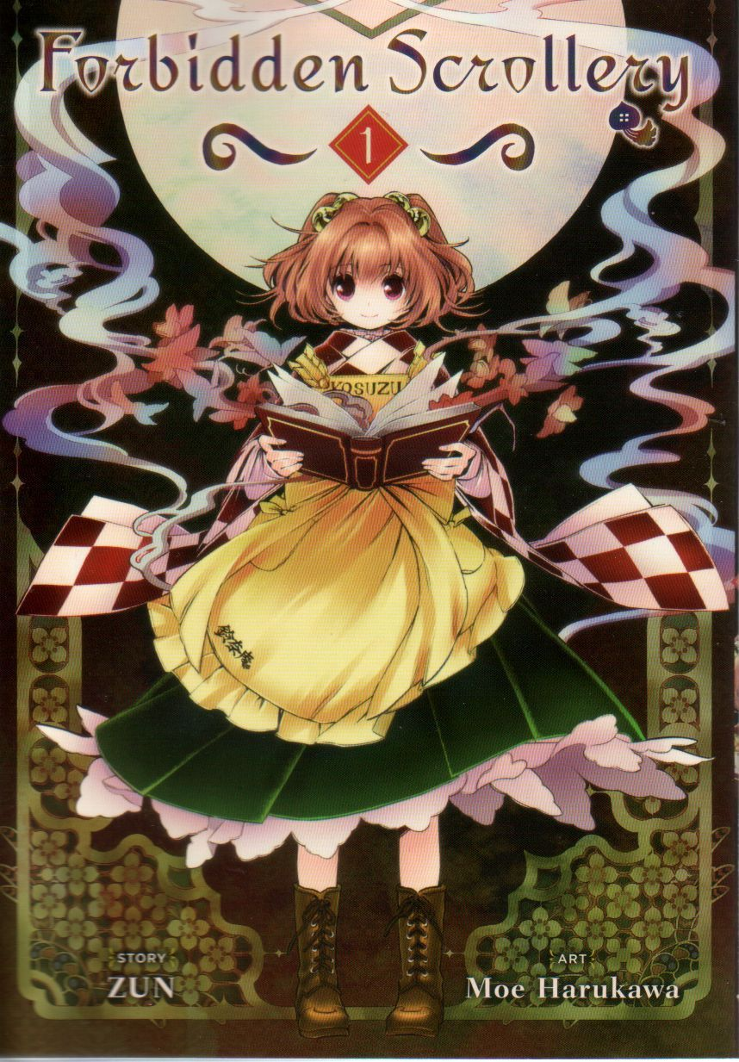

Manga
Fan made manga exist that have gone official. They are illustrated by various artists, and usually follow the story of something from the game series.
Current official series:
東方三月精 : Visionary Fairies in Shrine
東方儚月抄 : Silent Sinner in Blue
東方茨歌仙 : Wild and Horned Hermit
東方鈴奈庵 : Forbidden Scrollery
(Localized)
Notes:
A few of the manga have unique stories written by ZUN, that do not follow an already existing game. Some, bring out some of the personality of the characters that is not possible in the games. Forbidden Scrollery, however, is unique in that it is the only one to be officially translated into English and available at most book stores.

Slide 14
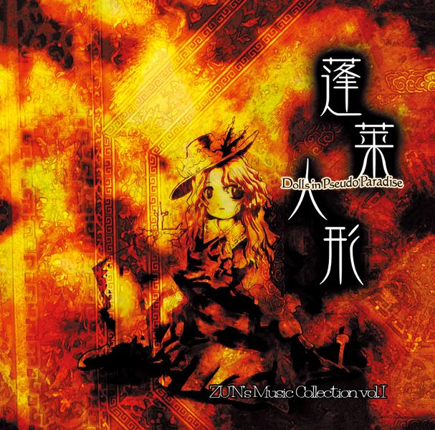
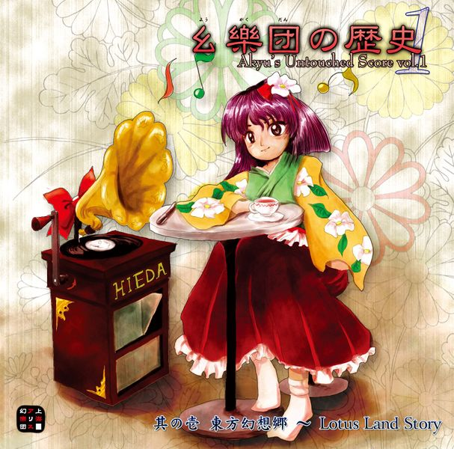
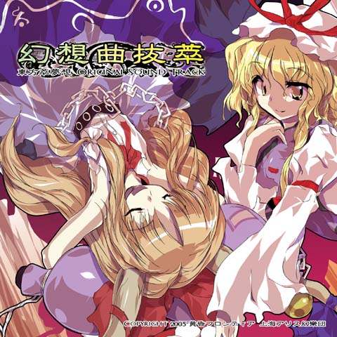
Official Music
The series is well known for its music. For each game, each character, there is always a unique track being made.
These are the types of soundtracks that exist:
ZUN’s Music Albums
Akyuu’s Untouched Score (PC-98 Soundtracks)
ZUN’s Bonus CD’s
ZUN’s Compositions
Fighting Game OST’s
Notes:
ZUN's Strange Works
Miscellaneous Midi tracks created by Zun, that have no direct relation to Touhou. Can be found at: https://www16.big.or.jp/~zun/html/music_old.html
These are PC-98 soundtracks, but also contain unused tracks.
These are rearranges of the music from the series and also Include stories of Maribel and Renko.
In various fanbooks and manga’s, Zun has included CD’s with original tracks.
In certain channels, you can find Zun has released sheet music for specific tracks he’s found of.
These are official arrangements by Twilight Frontier made for the fighting games of the series.

Slide 15





Fan Music
Because of the mass amount of music available from the series, and because most of the music is made available as MIDI, there are a lot of fan remixes in various different genres.
There are over 50,000 different fan made songs, from hundreds of circles around the world.
List of a few popular artists / groups:
IOSYS
Alstroemeria Records
East New Sound
Demetori
ALiCES EMOTION
Cclays
Cool&Create

Slide 16
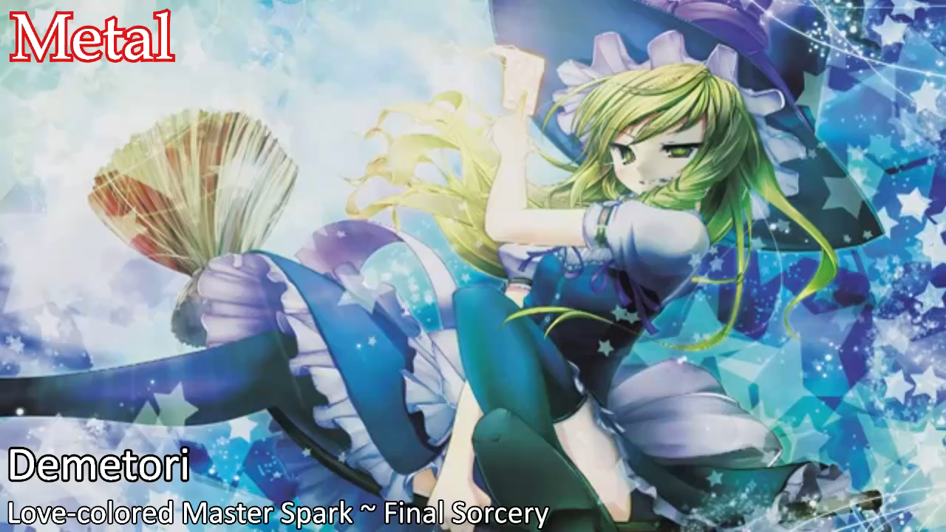
Fan Music Examples

Slide 17

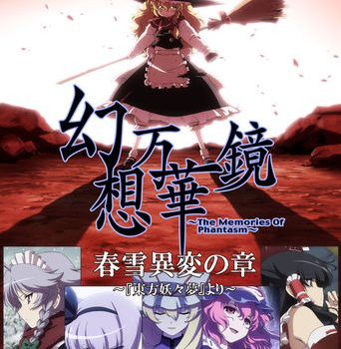
Fan Made Anime
A Summer Day’s Dream
An Unofficial Fan made anime with 3 episodes, created by MAIKAZE.
幻想万華 ~The Memories of Phantasm
Fantasy Kaleidoscope ~The Memories of Phantasm~
Another Unofficial Fan made anime by Manpuku Jinja. It currently has 10 episodes.
https://www.pixiv.net/member_illust.php?mode=medium&illust_id=71904237

Slide 18
Western Fandom
NitroInc. Collab (Wario Ware Clone)
http://nitorincmicro.games/
Gensokyo Radio
https://gensokyoradio.net/
Touhou VR
touhouvr.moe
Moriya Shrine
https://moriyashrine.org/
Mystery Parfait (Danmaku!!)
http://www.mysteryparfait.com/
There is much to offer within the US Touhou scene, with many groups continuing to gain members and explore each others’ love of Touhou

Slide 19




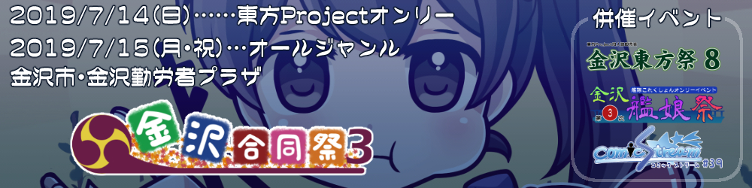
Events
Comiket
https://www.comiket.co.jp/
Reitaisai
https://reitaisai.com/
Niigata Touhousai
http://nigata.tohosai.com/
Dai⑨Shuu Touhousai
http://dai9.tohosai.com/
Kanazawa Touhousa
http://kanazawa.godosai.com/

Slide 20

Thank You For Attending
Join the fun at:
GreatLakesTouhou.com
Resources
http://www16.big.or.jp/~zun/
https://thepoltergeistmansion.wordpress.com/
http://touhouwiki.net/
http://touhou.wikia.com
http://www.reddit.com/r/TouhouMusic
http://vgmdb.net
http://www.shrinemaiden.org
http://www.doujinstyle.com
http://kafkafuura.wordpress.com

